Slide 2
The Confederation & the Constitution
The American Pageant,
Chapter 9

Slide 3
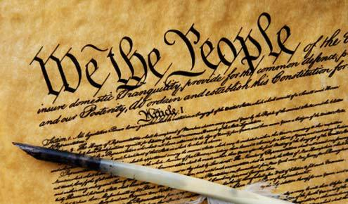
Revolution is Over. Now What?
Life carried on as normal for many of the colonists during the revolution
“Freedom” did not come quickly—it was gradual
Once we had it, we had to decide what to do with it (difficult!)
Patriots at odds again—not much unifying them
Economic troubles
Second-rate goods
One benefit: most of the thirteen colonies functioned similarly as individual states
Questions about social structure, customs, economic practices, politics, race, class, gender

Slide 4
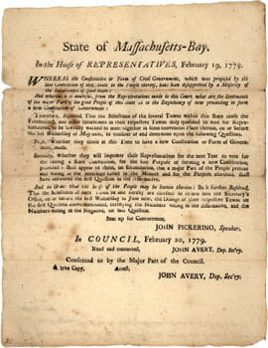
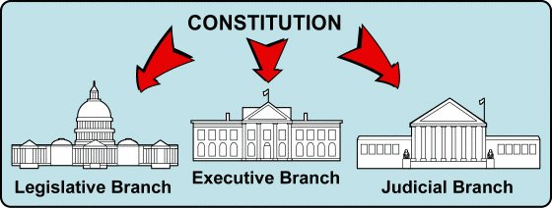
Constitution Making
Continental Congress, 1776
Draft new constitutions (declare yourself a free state!)
Largely republican and democratic (not party)
Massachusetts / convention / change
Oldest Constitution in the world!
Influence the federal constitution
Contracts—powers of government
Source of authority
Bill of Rights
Annual elections
Branched-government

Slide 5
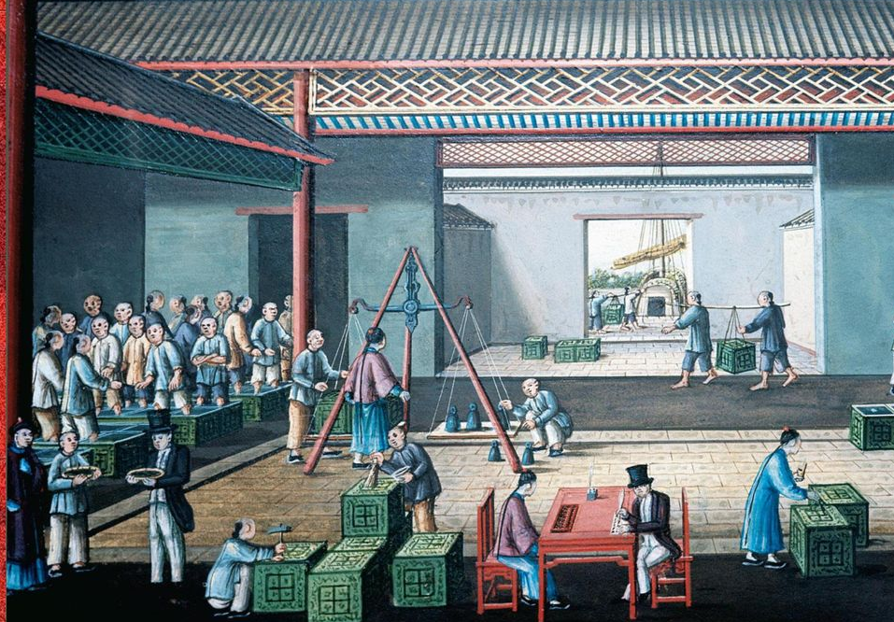
Economy
After revolution, states seize control of Loyalist holdings
Reduced to small farms
Largely industrial up north—non-importation agreements
Still largely agricultural
Some disruption in maritime trade
Ships cut off to West Indies / Navigation Laws
Still free to trade with other nations—helpful!
Depression, thought—states spent more money during the war than they could pay
Profiteers, inflation, etc.

Slide 6
The Articles of Confederation
Public lands transferred to power of the federal government—helps unite colonists; land to be purchased by farmers from Feds
Continental Congress of 1775—unconstitutional; no authority
Treason
Each state is individualistic, free
Making own money, militia, treaties, etc.
1777—Articles of Confederation (ratified by all 13 states by 1781)
Point of discord: land
Land rich states better able to pay off debts
Poorer states not as likely
But they helped fight for the cause! (kind of like the Seven-Years’ War)
Only way to pay off is through taxes—not good!
Argument—turn that land over the federal government
Land “poor” states hold out on approving the Articles until they know they have something!

Slide 8
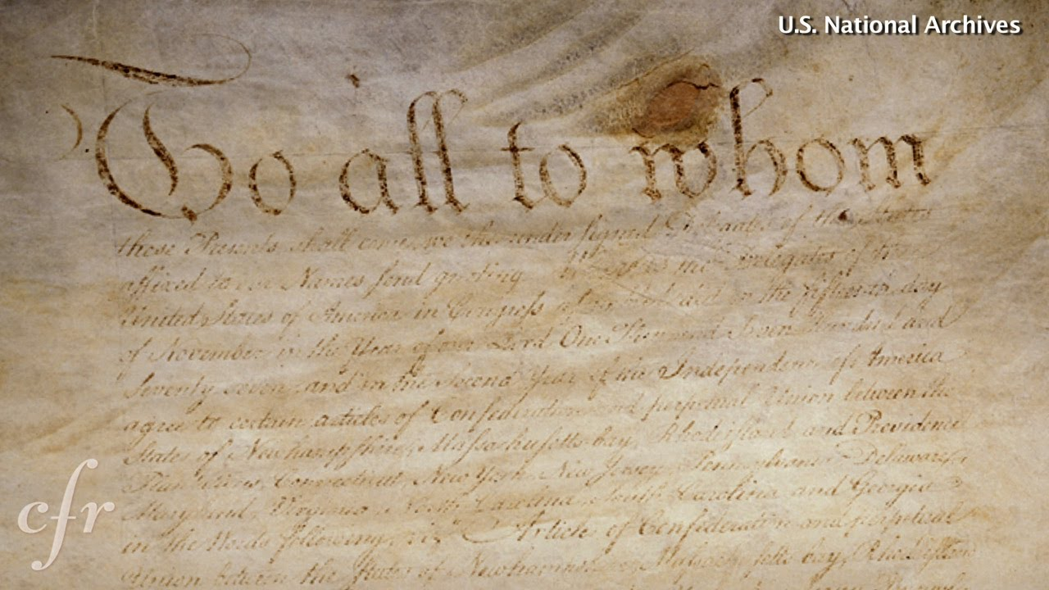
Our First Constitution
“Loose Confederation” / “Loose Friendship”
Point of it all—limit the power of the government
Individual over State
A Congress with no real power
No chief executive
Judiciary left to the states

Slide 9
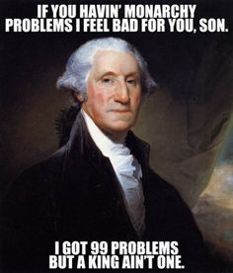
The Articles
Strengths | Weaknesses
 | Each state gets one vote—regardless of size
 | To get important bills through, 9/13 states must approve
 | Amendments must be passed by unanimous vote
 | Weak Congress (purposeful!)
 | Congress has no power to regulate commerce or collect taxes
 | -Taxes established; states asked to pay voluntarily
 | Federal government could advice and appeal, but not control states

Slide 10
The Articles
Strengths | Weaknesses
 | Could not act on behalf of the country’s citizens
 | Could not raise an army to defend itself/state
 | Less effective than the Continental Congress!
 | Created a federation, not a confederation
Established a Unicameral Congress //
Limited Power

Slide 11
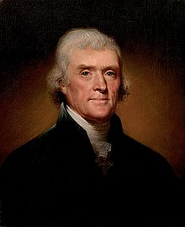
BUT…
Still exemplified what a loose confederation could be
The best one existing or that ever did exist!
Like Heaven and Hell

Slide 12
The Articles
Strengths | Weaknesses
**It does give us the building block of our current constitution
Outlines some central powers of the government
Congress can make treaties
Congress can establish a postal service
Landmark Laws

Slide 13
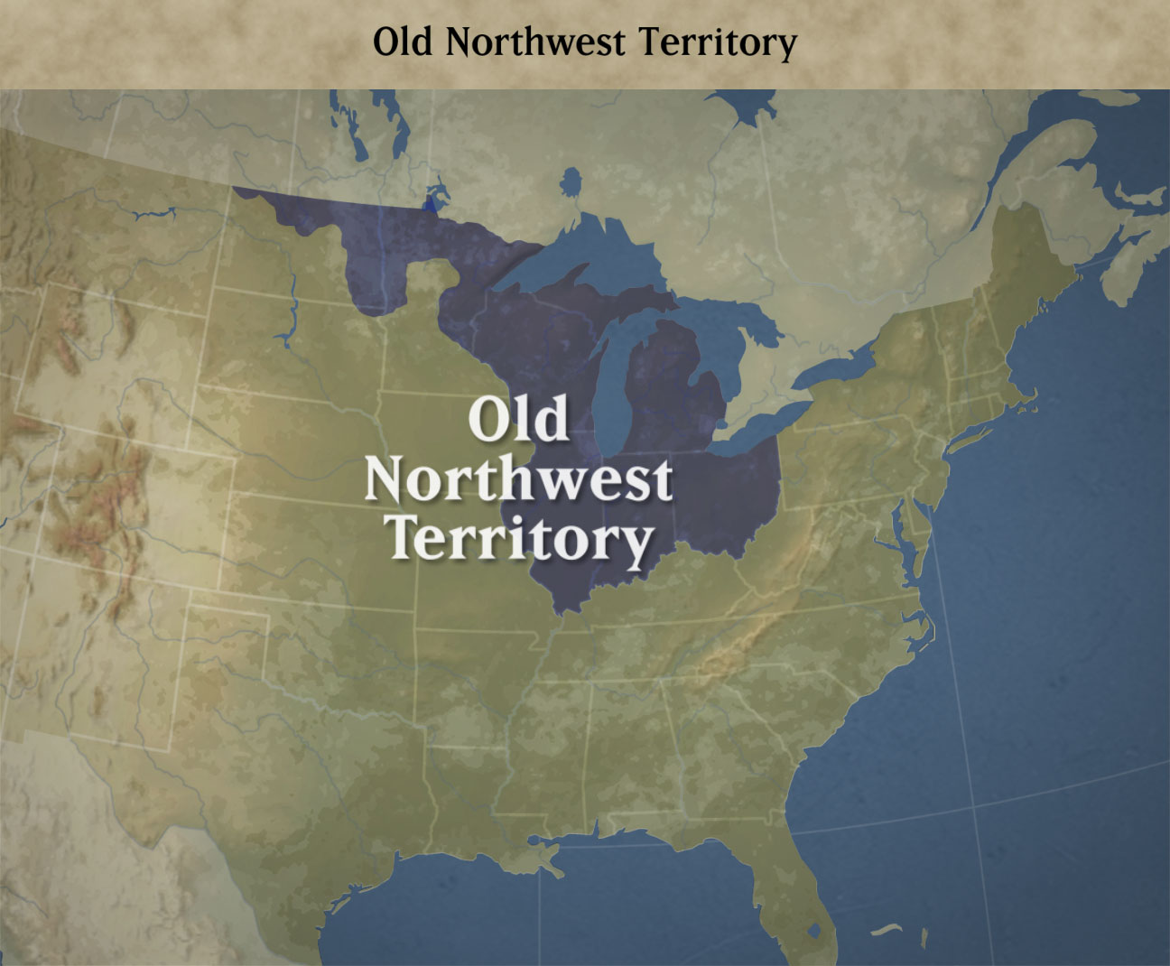
Landmark Laws
Old Northwest
Ordinance of 1784
As populations grow, territories apply for statehood
Land Ordinance of 1785
Sell lands, pay off debt
Survey land prior to selling
Part of land to be set aside for public education
Divides land into townships; down from there

Slide 14
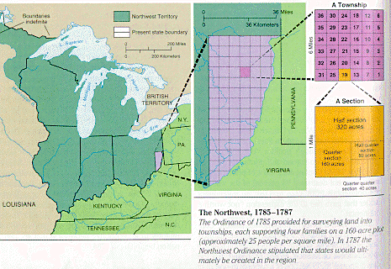
Landmark Laws
Northwest Ordinance of 1787
How should a nation handle its colonies?
Territory in the Union under the jurisdiction of the federal government
When a territory has 60k citizens, it can become a state
Forbids slavery in the Old Northwest
Slaves already present not included

Slide 15
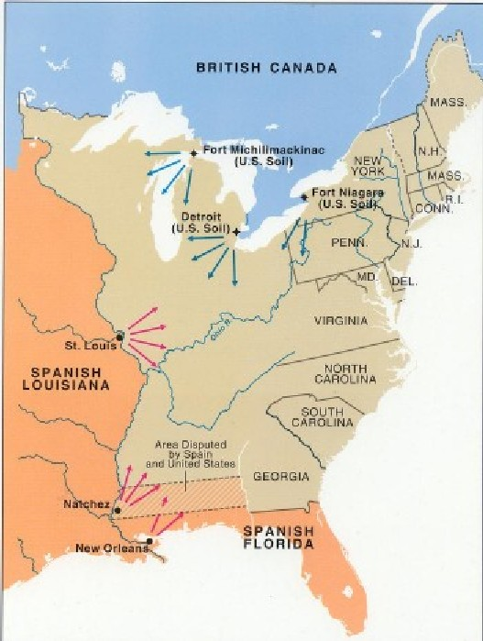
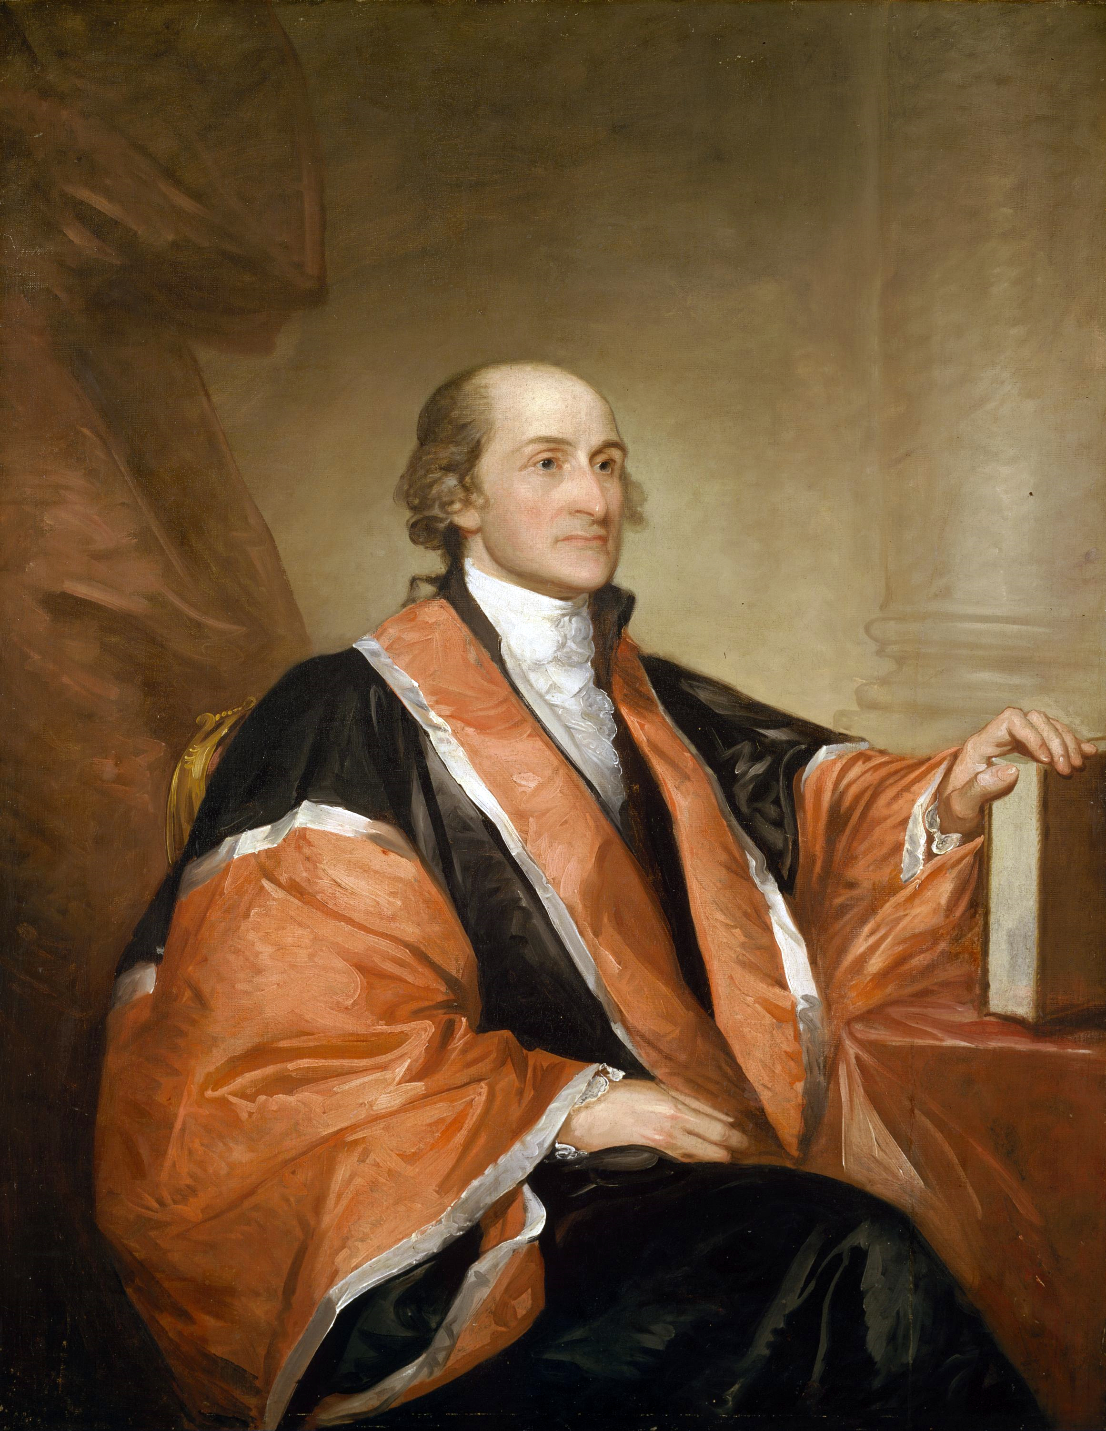
Trade Woes
Weak foreign relations
Britain still upset—reinforce Navigation laws; limit American trade
Still smuggled goods
Britain still holds territory on Northern border (Canada)
Continue trade with Natives / fur posts
Violating Treaty? Goes both ways…
Some citizens want to take action against Britain
The Confederation won’t allow it!
Spain helps us win revolution—cuts us off economically
France causes woes, too!
Mediterranean pirates
Facing problems? Good!
-John Jay, US Secretary for Foreign Affairs

Slide 16
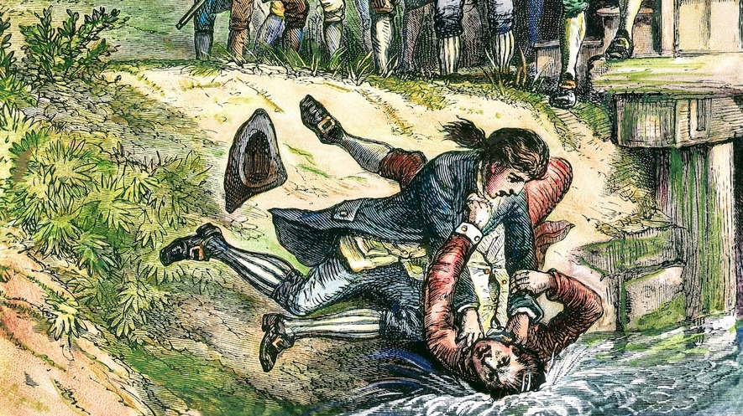
Shay’s Rebellion From Threats Outside the Nation, to Threats Within the Nation
States upset with “King Congress” – No Real Power!
Inflation is on the rise
States quarrel over boundaries; tax goods
Shay’s Rebellion—1786
Daniel Shays—Revolutionary Vet
Poor, backcountry farmers
Demand paper money; ease of taxes by states; suspend property takeovers
MA—uses money to raise a small army to shut down rebellion
Shays condemned to death, later pardoned
Federal government doesn’t act—too weak!
MA rescinds much of the laws—what’s next?
Democratic Despotism
Remember Bacon?
With time, things economically start to look up—still, something has to change!

Slide 17
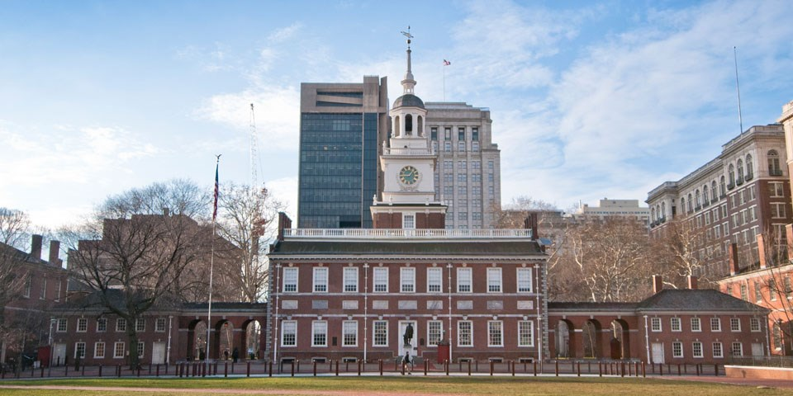
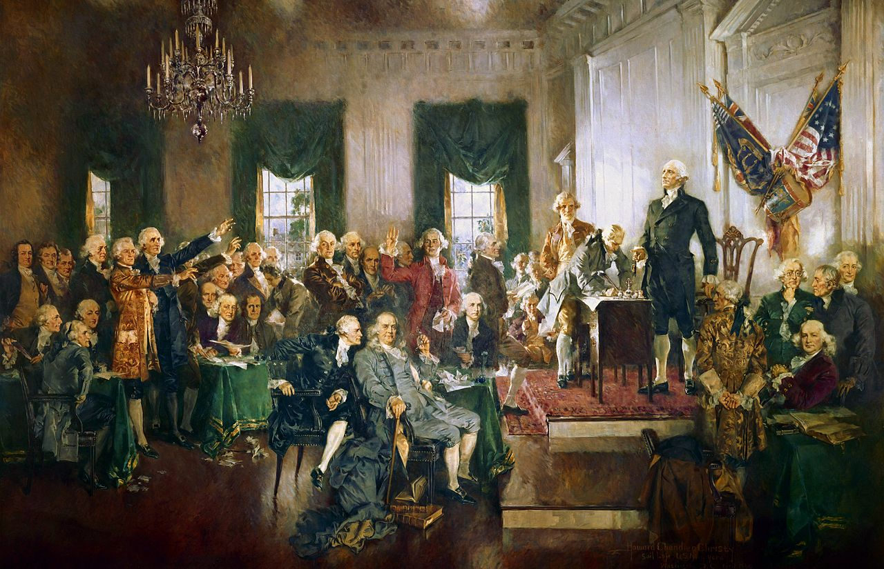
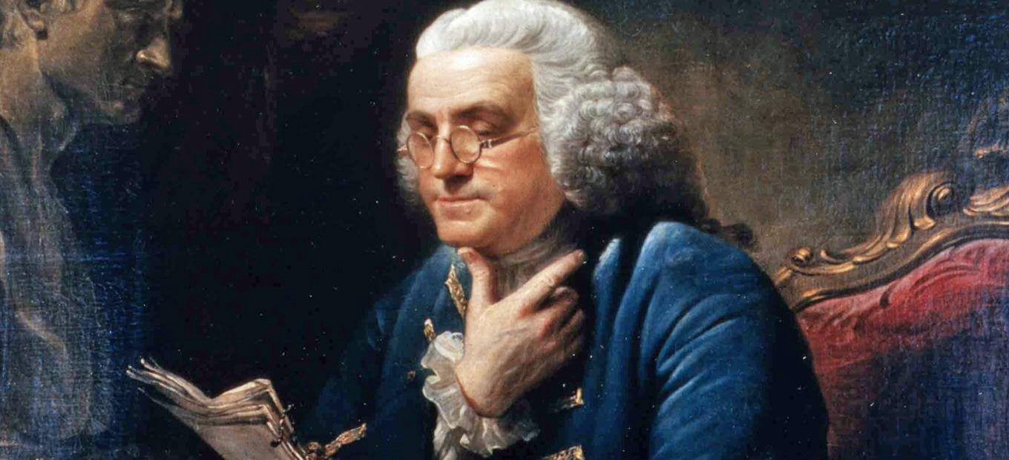
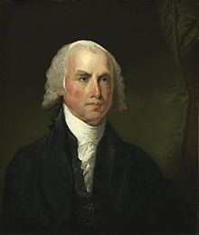
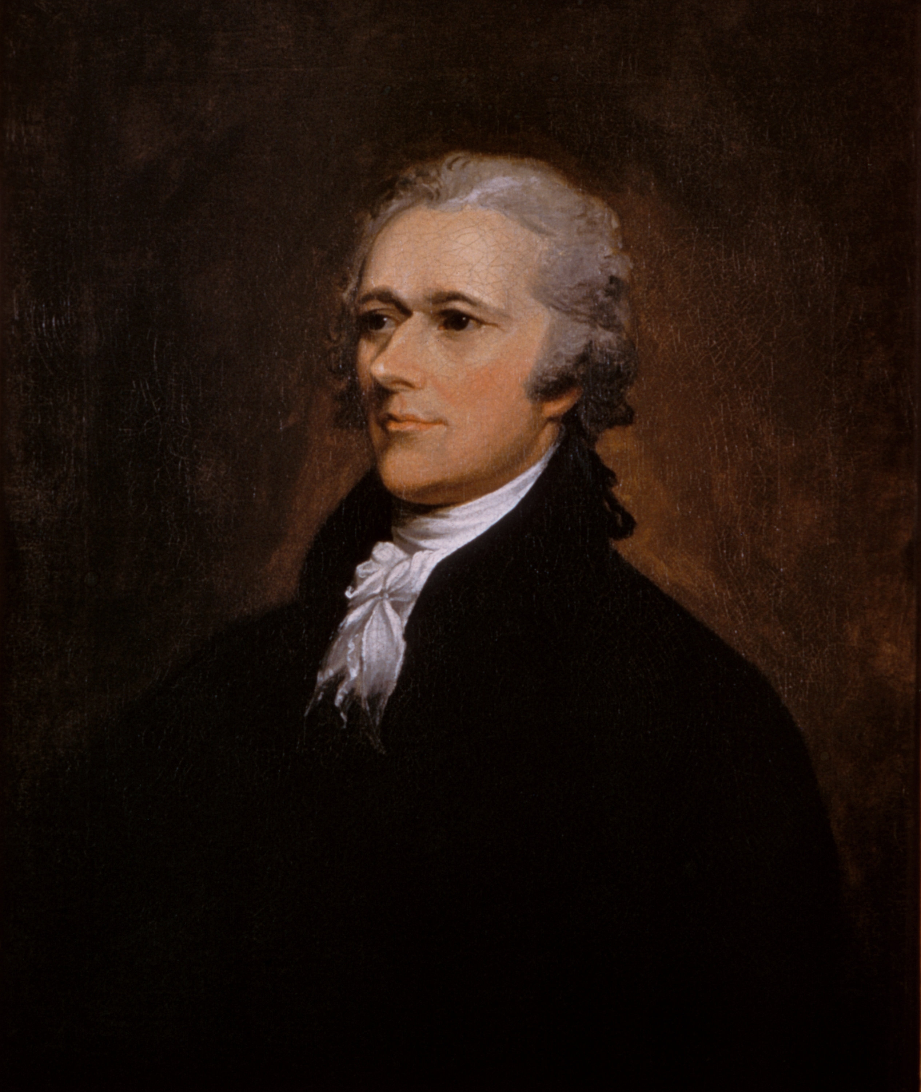
A New Convention
“Patriots” in Philly are all well off, well educated, own slaves, etc.
1786—Virginia calls for convention of States on Maryland
Nine states appoint delegates; only five represented
Hope to tackle the commerce issue—unable to
Calls for another convention the following year in Philadelphia
Goal: commerce and bolster the Articles altogether
All states but Rhode Island send delegates
Sent by legislatures who were elected by eligible voters
Meetings / sessions held in secrecy

Slide 18
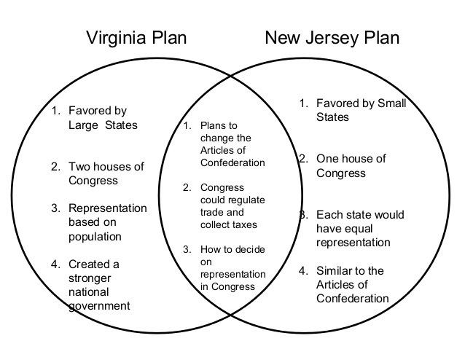
Compromises of the Convention
Other Features:
-Small Document
-Creation of a (limited) Executive
-Checks and Balances
-Electoral College [different today!]
Some want to scrap the Articles altogether, not revise
Virginia Plan (big state plan)
Create a bicameral congress
Representation in both chambers based on population
New Jersey Plan (small state plan)
Create a unicameral congress
Population equal among states
Great Compromise [ Article I ]
House of Representatives→ Population
All revenue bills originate in the House
Senate→ Equal representation

Slide 19
All Men Are Created Equal…But Do They Count?
If representation is based on population…
Slavery
North doesn’t want slaves to count as a person
South wants slaves to count as a person
3/5 Compromise
The word slavery never appears in the constitution until after the Civil War
Most states want to do away with importation of slaves
GA, SC protest
Importation allowed through 1807

Slide 20
Other Features:
-Small Document
-Creation of a (limited) Executive
-Checks and Balances/election of Congress
-Electoral College [different today!]
-Creation of Judiciary
Representation.
Consent of the Governed.
We, the People.

Slide 21
42/55 Representatives still around to sign the new document
Three of the 42 go home in protest
The rest—party in the USA!
BUT—only takes effect if 9/13 states ratify the new document

Slide 22
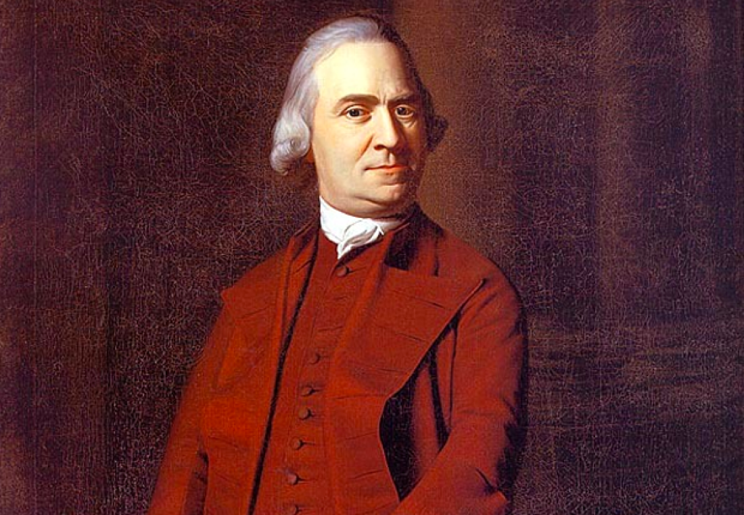
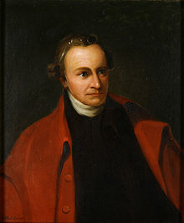
The Great Debate Sent to revise the document—now we have an entirely new one!
Federalists (Tories) | Anti-Federalists (Whigs)
Favored a stronger, more centralized government George Washington, Ben Franklin Wealthy and educated | New Constitution takes sovereignty away; too much power for government Sam Adams, Patrick Henry, Richard Henry Lee, Thomas Jefferson States’ Rights advocates / Poor “Gilded Trap” Opposed omissions of referencing God, establishing a capital city, creation of an army, etc.
Some accept, some reject. (Only 25% vote on special convention to approve the constitution!)
Federalist Papers (Hamilton, Madison)
How to get it passed? Bill of Rights!

Slide 23
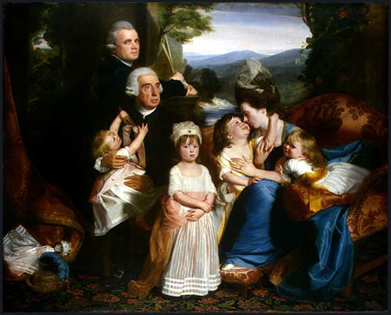
Equality Grows. Sort Of.
Reduced property-holding requirements to vote
Ordinary men and women now addressed as Mr. / Mrs.
Indentured Servants arrive in NY only to be released
Separation of Church and State
Slavery (PA)
Women
War
Voting
Republican Motherhood / Civic Virtue

Slide 24
The Goal is Zero!
American Revolution Ends
Shays’s Rebellion
First Continental Congress
Second Continental Congress
Navigation Acts
Boston Massacre
Lexington and Concord
Stamp Act
Royal Proclamation (Proclamation Line)
Seven Years’ War Begins

Slide 25
The Goal is Zero!
American Revolution Ends - 1783
Shays’s Rebellion - 1786
First Continental Congress - 1774
Second Continental Congress - 1775
Navigation Acts - 1651
Boston Massacre - 1770
Lexington and Concord - 1775
Stamp Act - 1765
Royal Proclamation (Proclamation Line) - 1763
Seven Years’ War Begins -1754

